Slide 1
Understanding the Experience & Needs of Exchange Students in Challenging Times
ESNsurvey - XIV Edition

Slide 2
Erasmus Student Network
works for the creation of a more mobile and flexible education environment by supporting and developing the student exchange from different levels and providing an intercultural experience also to those students who cannot access a period abroad.

Slide 3
Advocating for bettering of learning mobility
The advocacy ESN does regarding the general improvement of exchange programmes in Europe recalls the fact that it is based on the opinions of more than 350.000 students that we assist every year in our more than 1000 HEIs where we are present and whose opinion is collected in surveys and research.

Slide 4
ESNsurvey
Europe-wide research project
establishment in 2005
16 years of existence, around 200,000 responses
topics connected to mobility and education
carried out solely by volunteers
information about students’ experiences from their exchange period abroad

Slide 5
ESNsurvey: ESN’s main policy tool
The data informs ESN’s activities and policy work
It has allowed ESN to advocate for a better Erasmus+ programme in issues such as funding, inclusion and civic engagement
The ESNsurvey has given unique insights into the needs of exchange students, leading to the creation of new initiatives at the European, national and institutional levels

Slide 6
Exploring current issues connected to academic and non-academic mobility and education
Getting an insight into student issues to represent their real needs

Slide 7
14th edition of ESNsurvey
10K
mobility students' opinions gathered
on the experience of the students, the support they receive, and the impact that mobility has on their lives once they go back home.

Slide 8
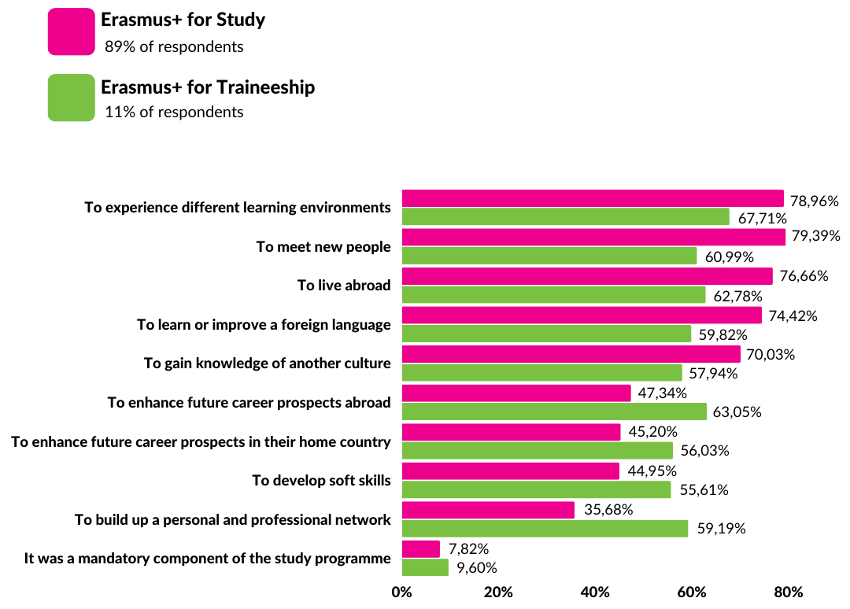
Participants in Erasmus+ studies and Erasmus+ traineeships report different motivations
to take part on mobility
Experiencing different learning environments
Meeting new people
Living abroad

Slide 9
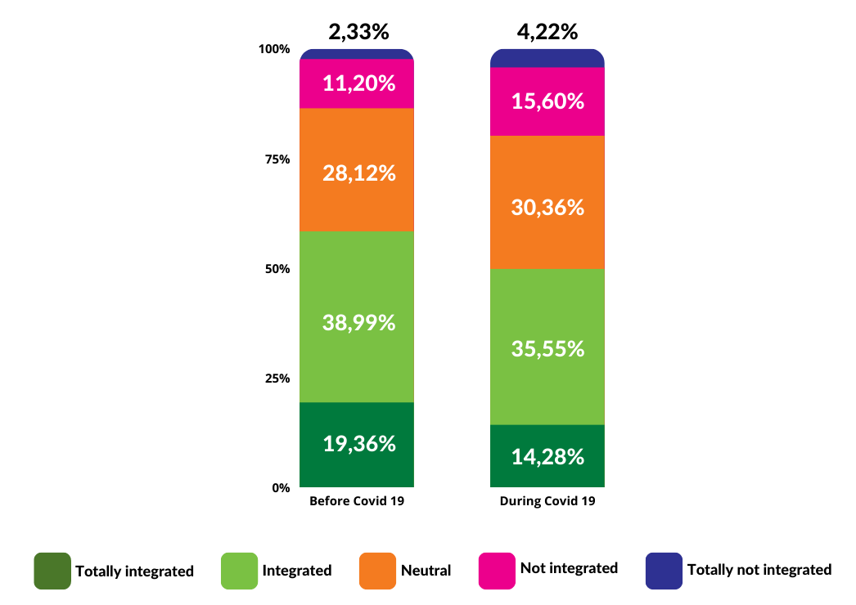
Almost half of the respondents
did not feel integrated with the local community

Slide 10
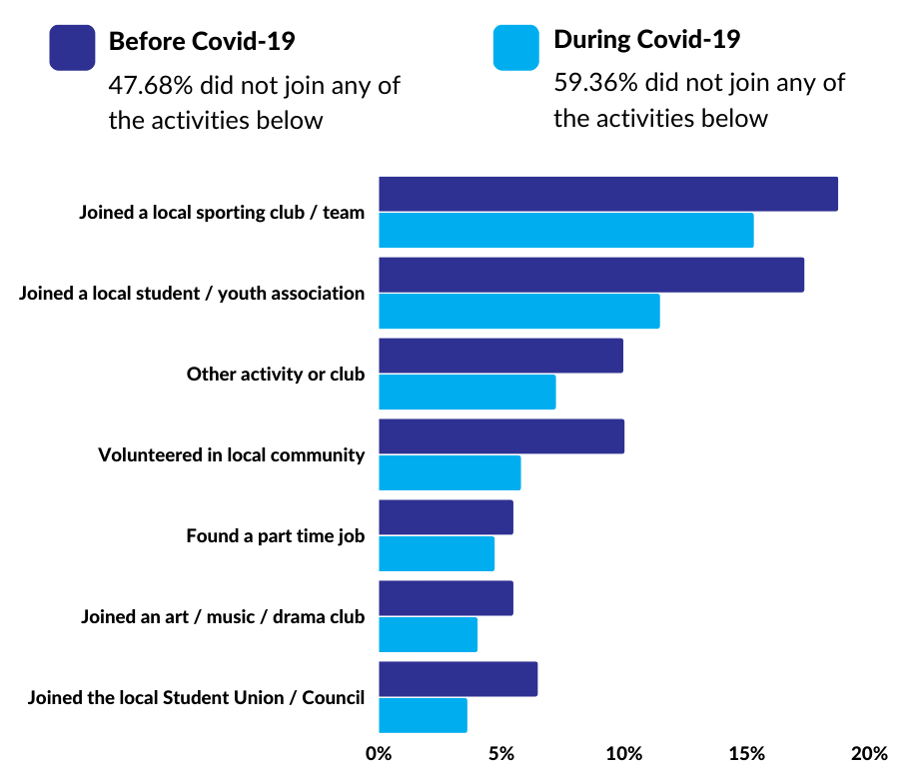
55%
did not take part in organised group activities in their hosting communities
8%
less than
volunteered
in the local community

Slide 11
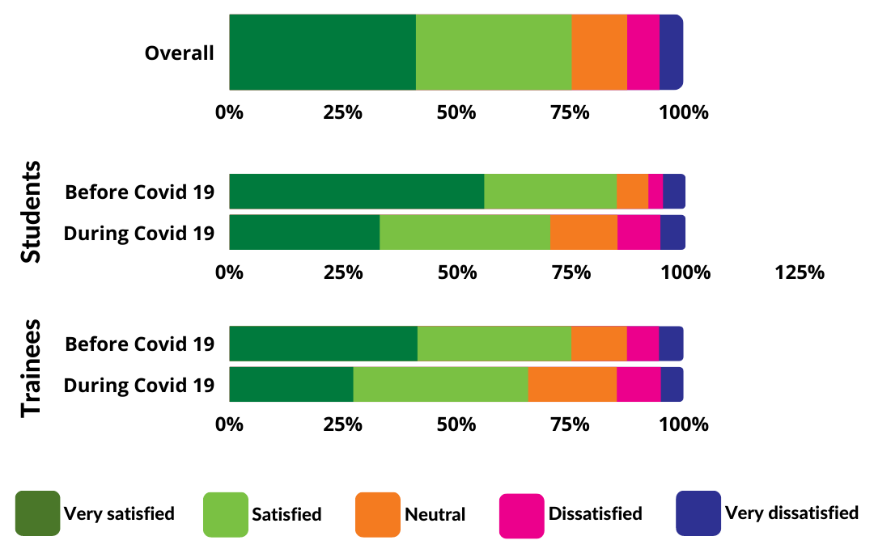
Satisfaction with social life
Drop from 85% very satisfied or satisfied to 70%
Increase from 8% very dissatisfied or dissatisfied
to 14%
Drop from 75% very satisfied or satisfied to 65%

Slide 12
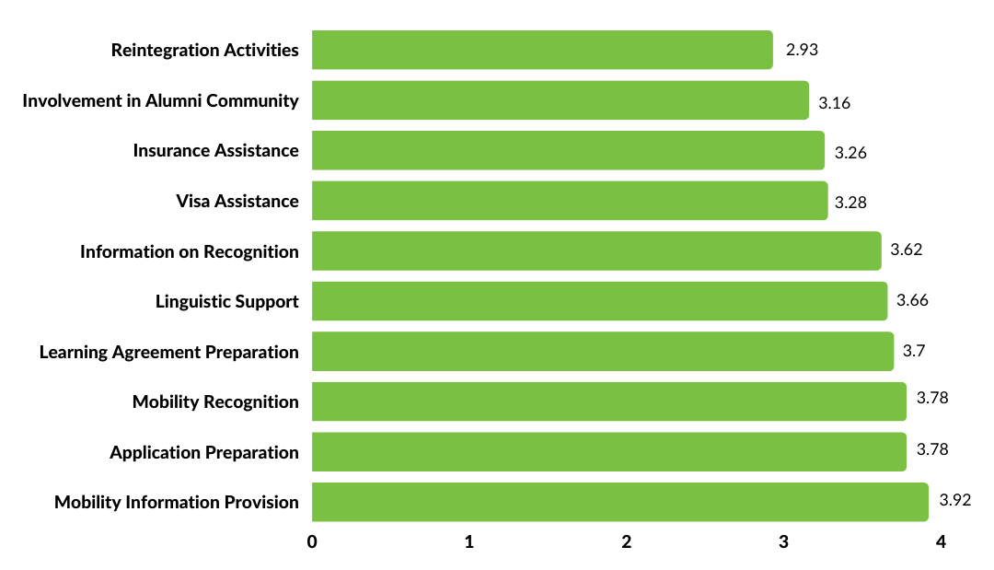
Reintegration activities and involvement in alumni communities have
the lowest levels of satisfaction among the services provided by sending institutions, while application preparation and mobility information provision score the best results.

Slide 13
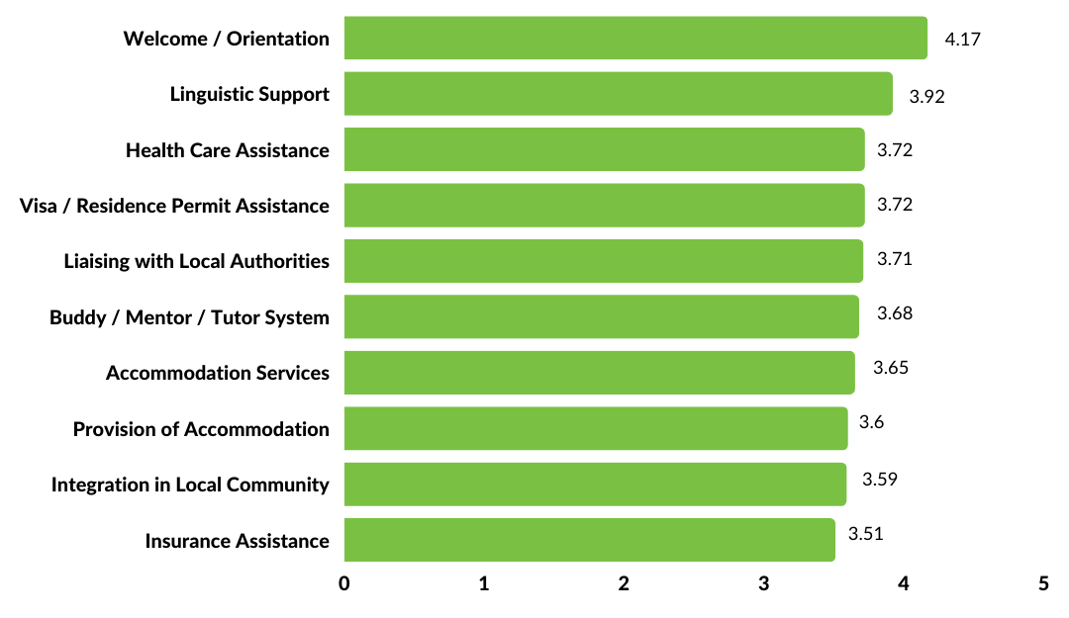
Among the services provided by host institutions, insurance assistance, integration in the local community and Accommodation receive the lowest levels of satisfaction.
Welcome activities and linguistic support receive the highest satisfaction rates. The services provided by student organisations in the host institution also stand out for the level of
satisfaction.

Slide 14
Sending HEIs vs. Host HEIs
application preparation, mobility info
welcome activities,
linguistic support
reintegration
insurance assistance, integration, accommodation

Slide 15
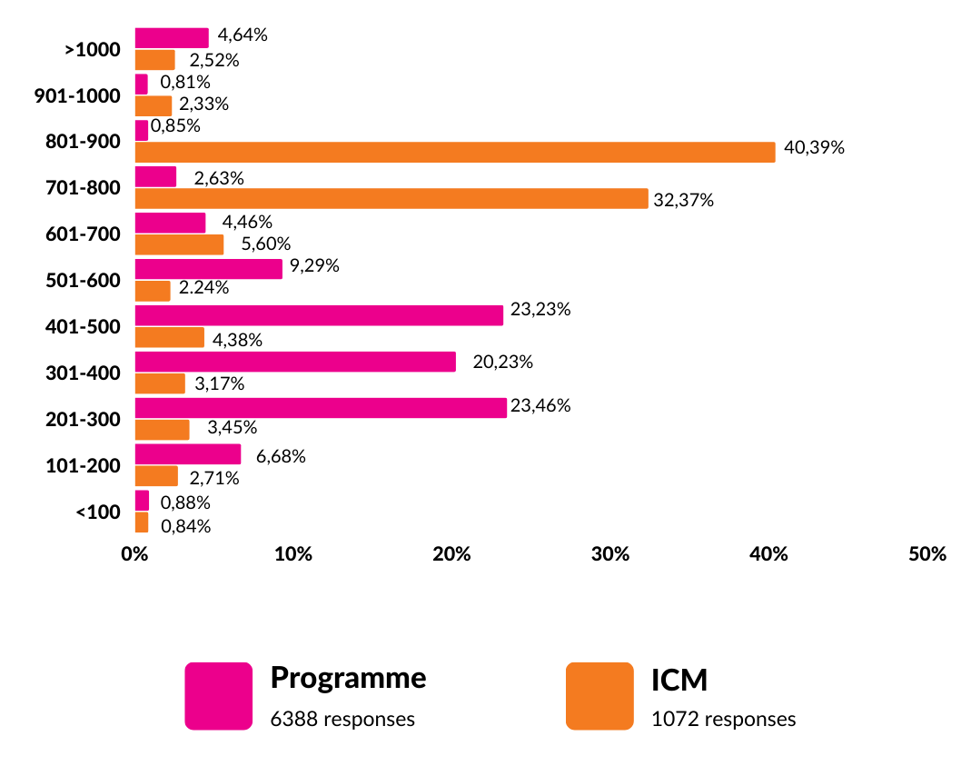
How much is the average Erasmus+ scholarship?
€200-500
per month
In the Erasmus+ Annual report 2020, the average grant was
374 euros per month

Slide 16
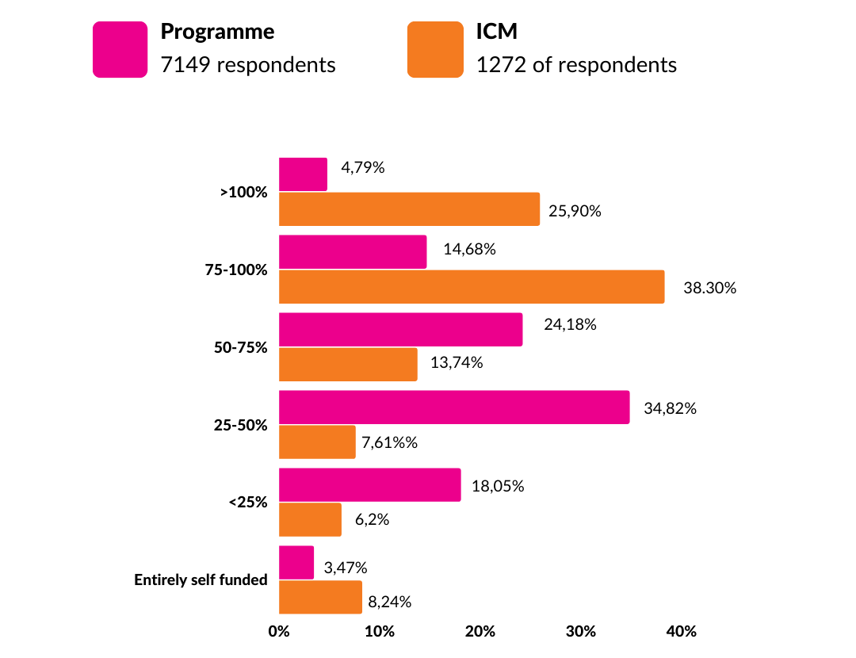
50%
can't cover more than half of the costs of their mobilities

Slide 17
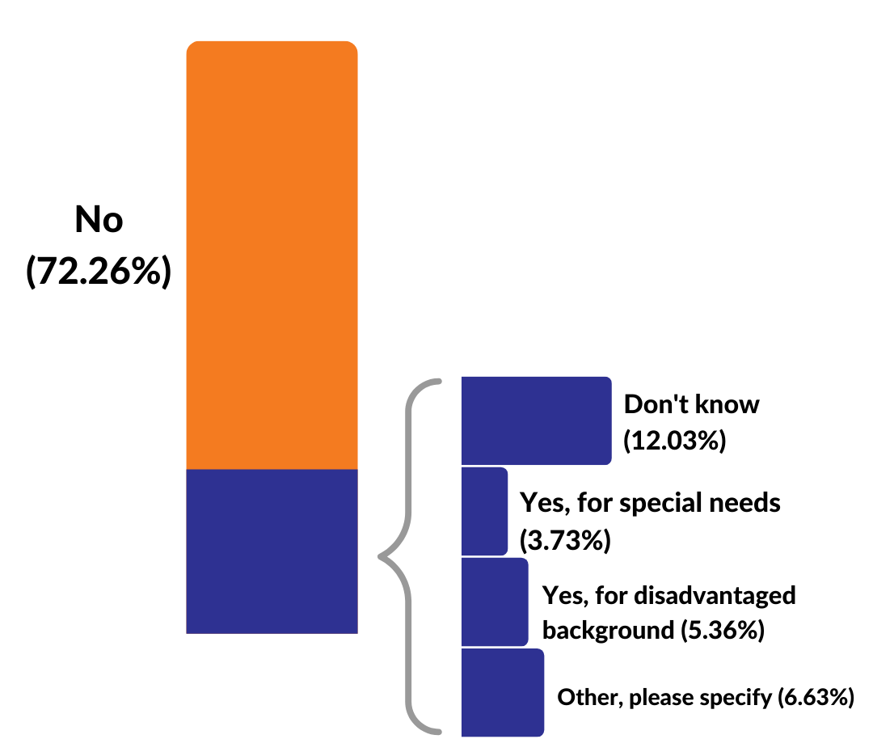
More than 12% of respondents reported
not knowing whether they had received top-ups or not

Slide 18
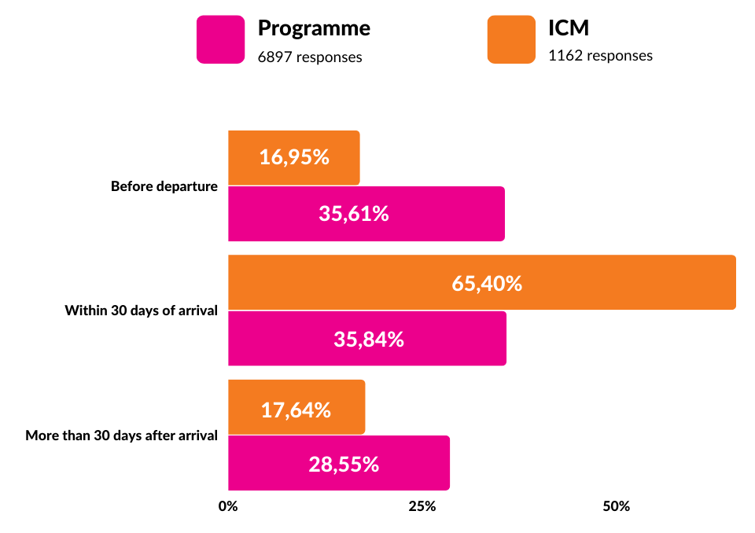
More than 1/4 received their grants later than
1 month
after the beginning of their mobility
*France, Spain, and Italy have a more extensive prevalence of late payments

Slide 19
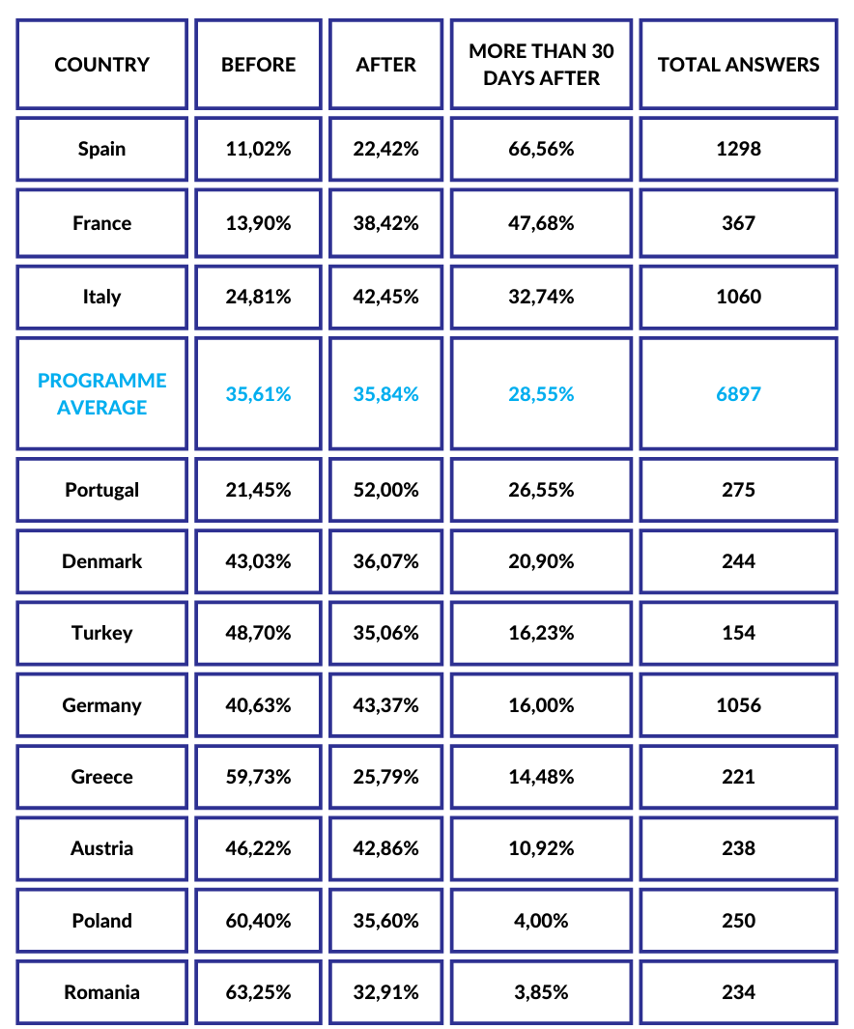
Timing of grant payments
South - Western European countries report the latest grant payments. These are upcoming in Central, Eastern and Northern Europe

Slide 20
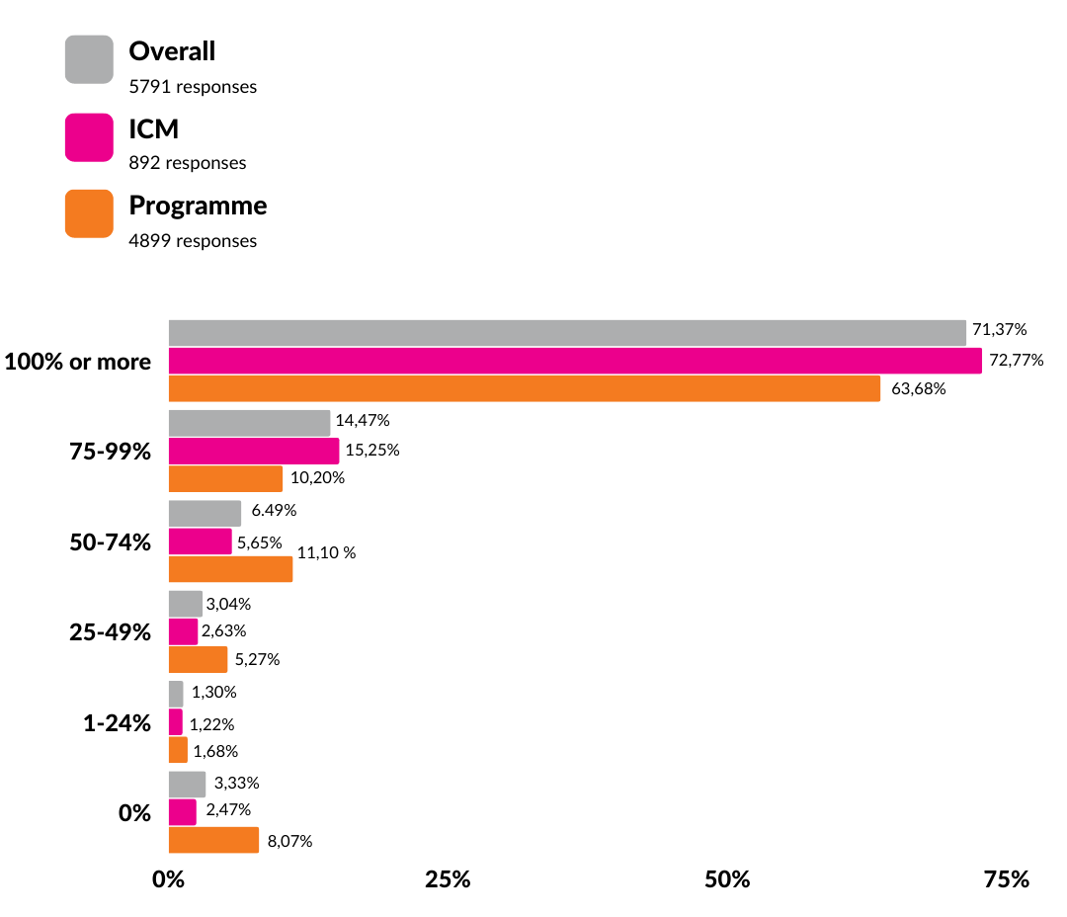
1/3 of reported not receiving full credit recognition, far from the objectives laid out in the ECHE
73%
64%
ICM
E+

Slide 21
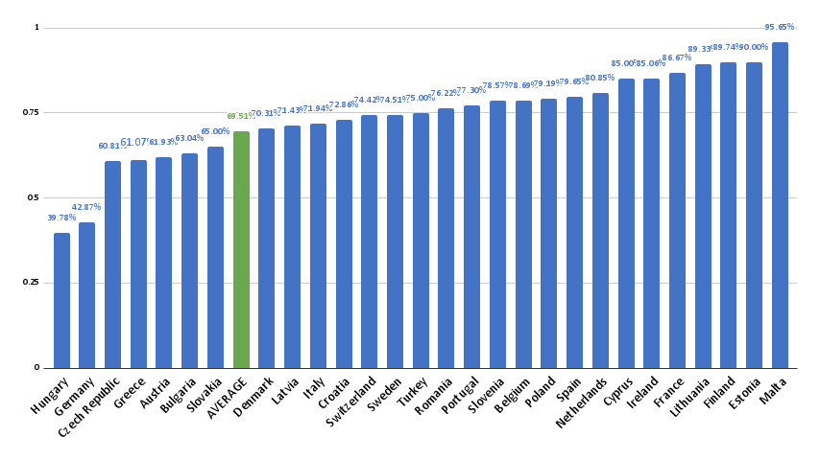
Challenges in credit recognition persisted until the end of the previous Erasmus+
Remarkable national difference point to the importance of the implementation of Bologna tools and the Automatic Recognition Council Recommendation

Slide 22
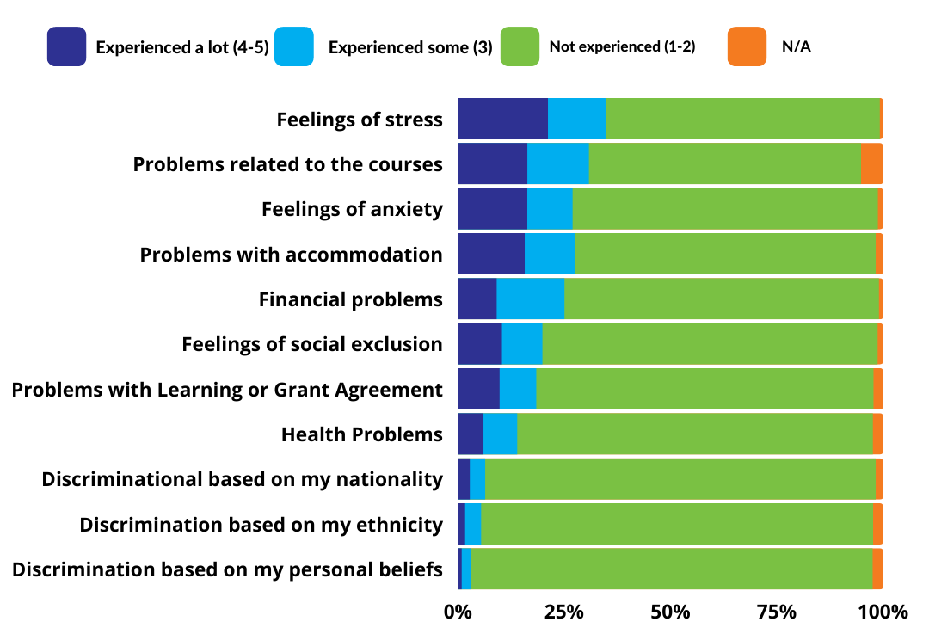
Main issues
encountered by students
Stress
Course-related problems
Anxiety

Slide 23
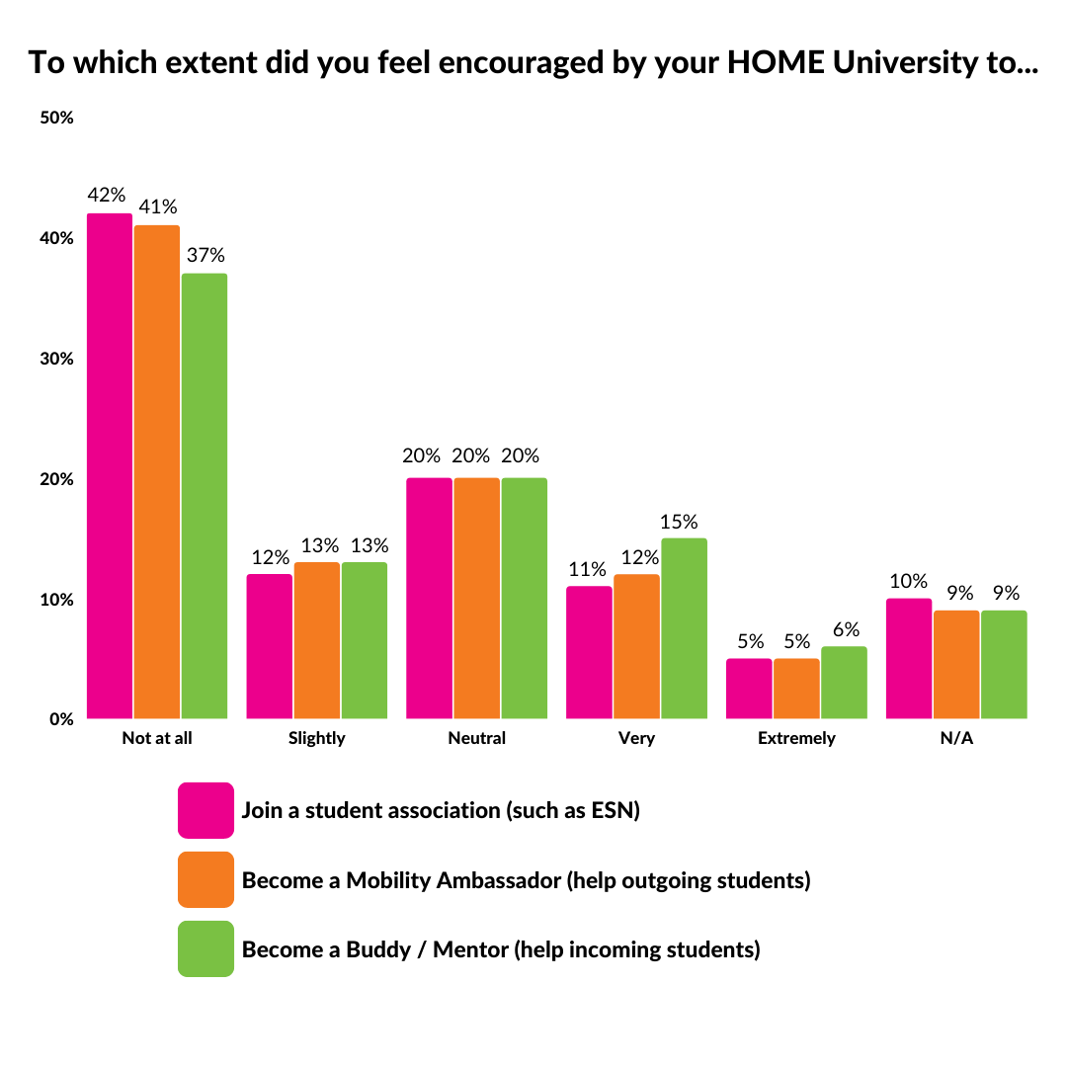
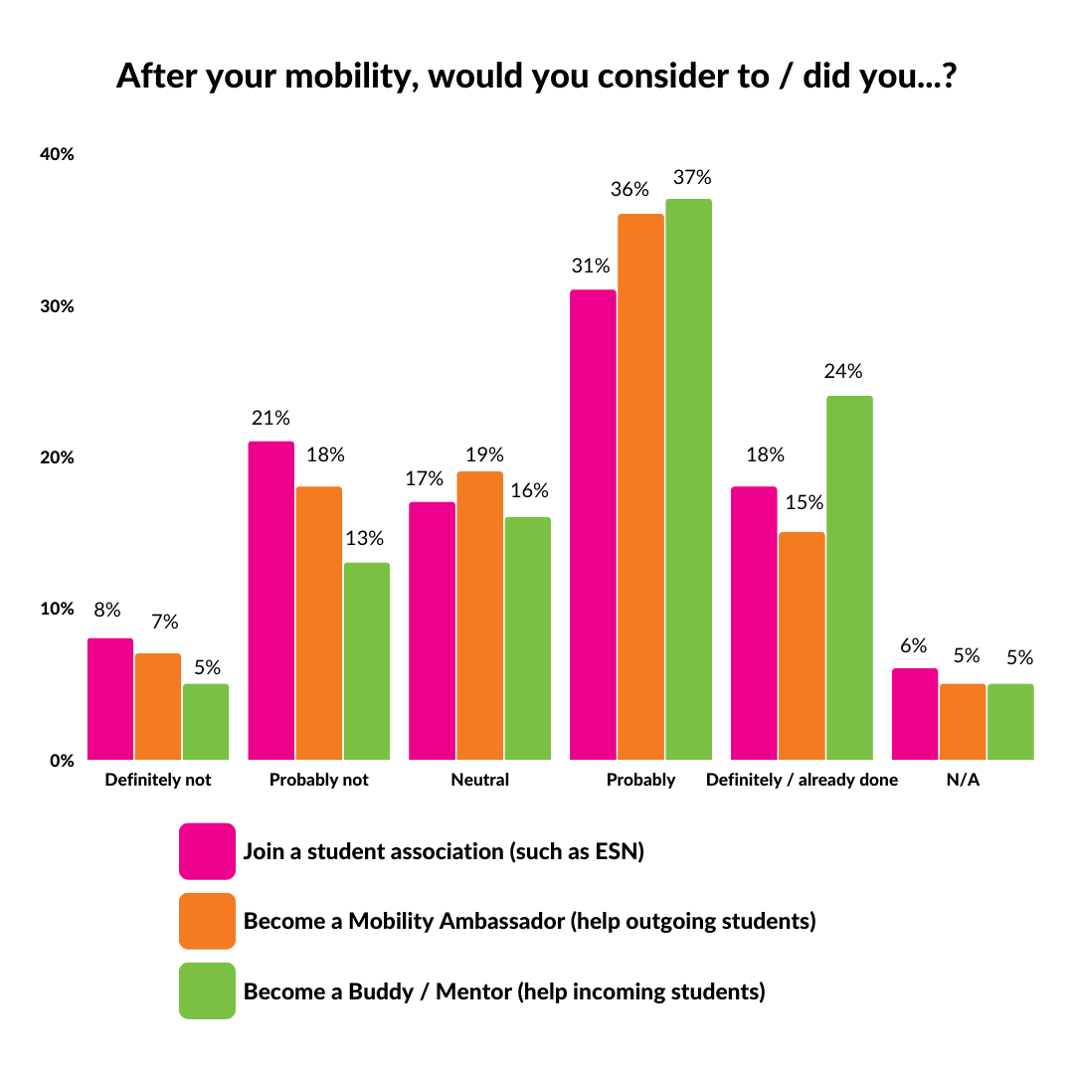
Students as mobility multipliers

Slide 24
A majority of respondents are keen on becoming multipliers of their
mobility experiences and supporting other students as members of associations, ambassadors or buddies...

Slide 25
but less than
1/5
felt encouraged by the home HEIs to do so

Slide 26
Student mobility fosters internationalisation, global citizenship and
European identity.
How much did you identify with the following before and after your mobility?

Slide 27
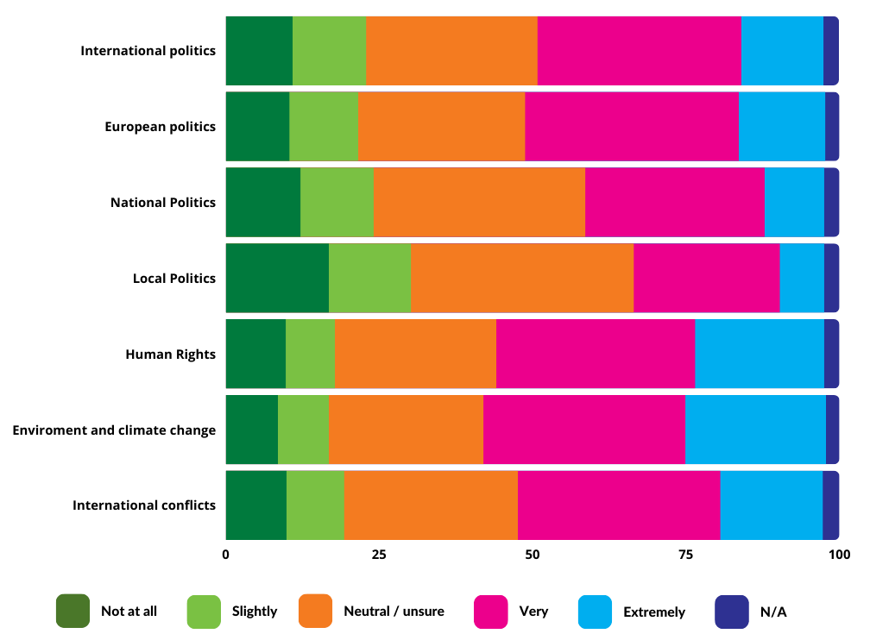
Did you increase your interest in any of the following topics during your mobility?
More than half reported that their mobility had an impact on their
interest in climate change and the environment

Slide 28
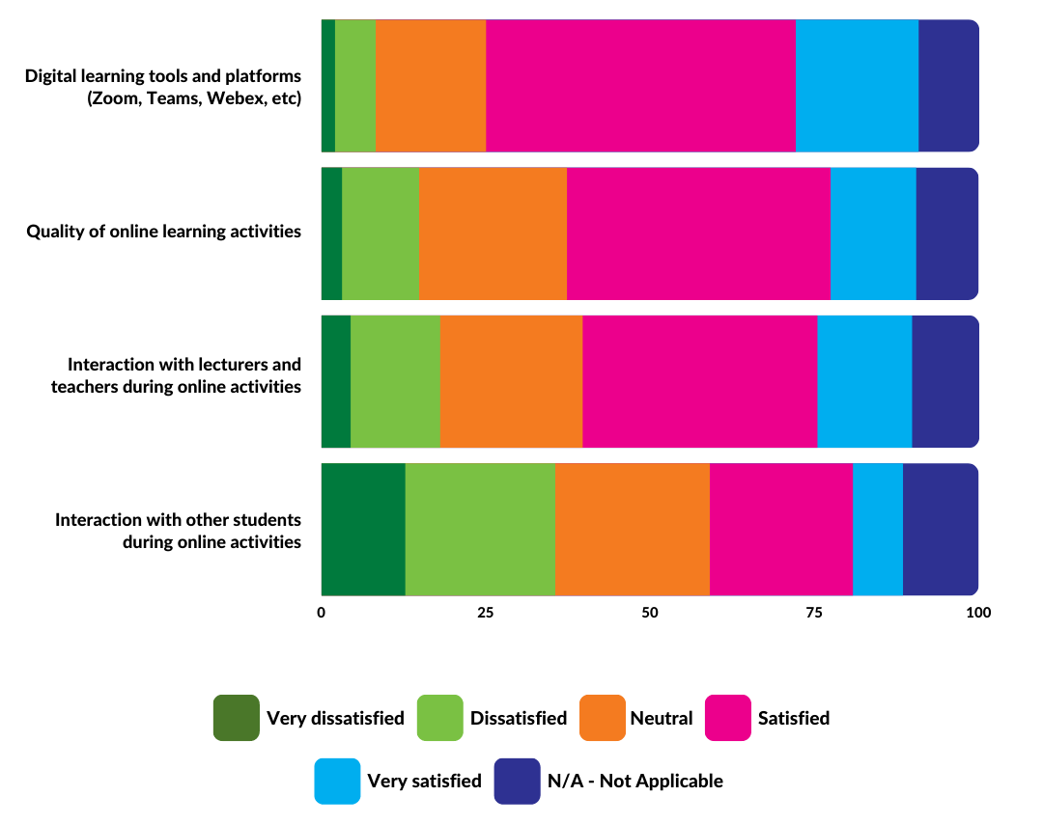
Satisfaction with the different elements of online learning activities
dissatisfied or rather dissatisfied
with the interaction with other students

Slide 29
Name Surname | position
email contact
www.esn.org

